Slide 1

Harris
HR Change Management RFP response
June 2019

Slide 2
Proposal Site Architecture
HR Leading Change at L3 Harris
Site name, top left
Home icon and home page elements
Meet Your Team
Why Willis Towers Watson
Top Navigation Bar
Home page Image Carousel
Image sliders
1: Power Ambition
2: Seize Moments 3: Connect the Dots
Primary Section Boxes:
[Our Approach/Preparing you to Lead? ]
Connecting to Individuals Success Stories
Excel Response and Indicative Fees
Under Carousel

Slide 3
Primary Section Boxes on Home Page
Microsite Module | Box 1: Our Approach/Preparing You to Lead | Box 2: Success Stories | Box 3 Excel Response and Indicative Fees
Page | Intro paragraph above tabs – POV Two aspects: Change Management and Change Leadership Video with either Phil or Gabby (we have one with both explaining the difference) | Which TBD | Intro paragraph Image of exel? and link to document Summary of Fees
Tab 1 | Change Management
Tab 1 Accordions (Currently tabs in template) (Note: changing text from “we” to “You” or omit | Lesson’s learned (existing on site) Why changes fail (existing) How you succeed Levers you pull (we need to make this responsive if possible)
Tab 2 | Preparing You to Lead [vs. Our Approach?] Intro paragraph Diamond Chart
Tab 2 Accordions | Each accordion will be a column of what we currently have on slide 7. Subheads in between sections and current rows as necessary
Tab 3 | Connecting with Individuals [Tools to Accelerate Communication and Success] Intro paragraph Ecosystem Graphic
Tab 3 Accordions | Accordion for each tool (Microsite, AutoM, Virtual Focus Groups, Texting, Podcasts, Live Town Halls with Webcast? Environment Visuals?)

Slide 4
Ambition
Microsite: Home Page
Your ambition.
The merger of equals creates a top defense company globally. You will:
Create scale with a well-balanced portfolio
Strengthen capabilities and expand customer relationships in over 100 countries through complementary businesses
Accelerate innovation and time to market
Have a stronger platform for continued growth
Enable greater career prospects at a larger, more diversified global defense technology organization

Slide 5
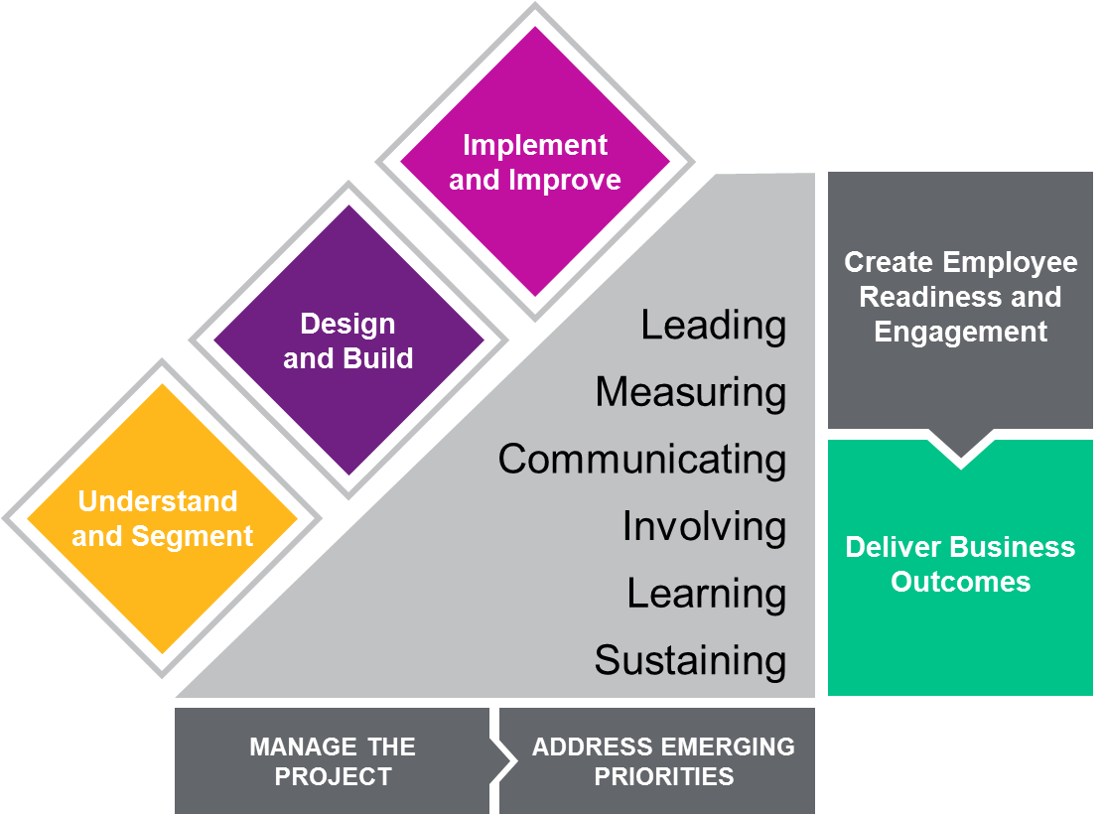
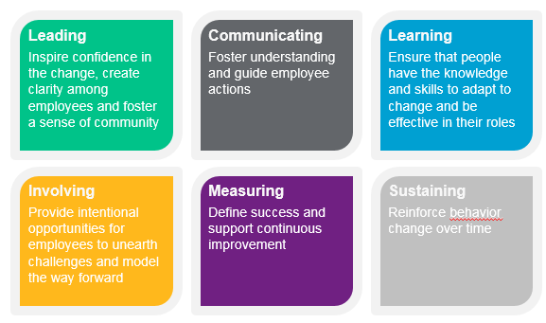
Our Change Management Methodology
Willis Towers Watson research shows that most companies focus on six levers to manage change:

Slide 6
Change Management Approach - Overview
We suggest continuing with the Agile methodology and sprint schedule in order to move quickly.
PLAN
ESTABLISH
MOBILIZE
INVOLVE
OWN
Sprint 3:
Activate leaders, change agents and communications
Sprint 1:
What’s changing and for whom
Sprint 2:
Establish groups, communications and the plan
Sprint 3:
Test your EVP prototype
Sprint 4:
Involve groups in the change and launch learning
Sprint 5:
Imbed change through ownership
CONTINUOUS STAKEHOLDER ENGAGEMENT AND CHANGE MANAGEMENT
Week 1 | Weeks 2 - 4 | Weeks 4 - 6 | Weeks 6 - 10 | Weeks 10+

Slide 7
Change Management Approach - Detail
What’s changing and for whom | Set up | Mobilize | Involve and Educate | Create Ownership
Hold project kick-off meeting with core team (personnel to be decided by Director HR Strategy) Kick-off communication to HR explaining the change management approach and work Conduct Stakeholder interviews with key HR personnel – likely to include the HR function leaders, workstream leaders and HRBPs to gather input on HR priorities, business priorities and key changes Conduct high-level desk based Culture Analysis of Harris and L3 Based on employee engagement survey data held by WTW Meet with the 12 HR Workstream leaders to conduct detailed review of workstream plans Conduct desk based review of Meet with Merger Team to understand current state integration plans including: Merger process and timelines Key activities and changes Based on the above activity, create a Change Impact Assessment and Heat to assess and prioritize the change management needs | Establish Change Agent Network (CAN) Using snowballing techniques, identify the key influencers in Harris and L3 to form part of the CAN community Invite them to be part of the group Develop cornerstone communication materials including: Key message repository board Ambassador “Deck” (hard copy material or online) Set up communication infrastructure including: NewCo Microsite AutoM direct communication Leadership Podcasts Hold Change Leadership workshops for HR to train people on the change methodology and on change leadership skills (focused on change in a merger situation) Develop training needs analysis. This will identify the following: The philosophical, process, structure and system training needs The audience segments – so we are clear on which pieces of training need to be delivered to different groups The timing and sequence requirements The most optimum training delivery environment Develop first phase HR Change Management Roadmap to determine the activity and timing Socialize plan with IMO team and Senior Leaders to facilitate buy-in | Kick-off Change Agent Network (CAN) Hold kick-off sessions to establish role, share materials and prepare for initial activity Deploy online HR Change Management Toolkit. Material likely to include: Post-close and integration plan talk points and narrative Core “deck” (paper/online) outlining key message and activities/updates for the function Role of the Change Agent (key points from training sessions) Integration process overview and key details Communication best practices Culture assessment and watch-out points Specific job aids for HR personnel Begin HR Function Town Hall sessions Held at key locations and/or HR groups HR Leadership Team led Launch HR Leadership Podcast series Leaders discuss NewCo integration, plans for the Function, share views on the roadmap for change and respond to questions Launch HR AutoM Newsletter Establish regular direct to individual communication approach Develop Training Strategy and Plan The first pass training plan – i.e. the timing and sequence per group The training methodology and medium – i.e. what training methods we will use and how we will deploy it per event | Hold series of HR Function Virtual Focus Groups Gather insights and suggestions on what is necessary to drive change Have people contribute to and problem solve to the change management agenda Seek feedback on how the changes have been managed thus far Understand what people want to hear more about Launch online/interactive Training Series Bite-sized learning modules focused on key change items. Focus on core aspects of change such as: HR Strategy – how the function is organized, how the service is delivered, operating requirement etc HR Processes and Service Delivery Technology and Systems Launch Culture Clinics Onsite sessions co-facilitated by Senior Leaders and the Change Agents Sessions designed to bring NewCo culture to life and HR Functional culture Launch Merger Monitor Pulse Survey To gather regular input on integration progress and activities to inform the change management roadmap | Continue regular communications AutoM direct communications to keep people regularly informed Reiterate core messages Push people to published content Add new modules to Training Series Typically focus in on key changes such as Total Rewards or customer service Continue to equip leaders with necessary materials to ensure they are able to hold face-to-face engagement sessions with employees Embed HR based changes – such as new roles, new HR services – via training and job aids
Key Deliverables
Kick-off meeting Stakeholder interview guide and post interview summaries High level culture analysis of Harris and L3 Change Impact Assessment report showing key changes per audience segment | Snowball survey to identify change agents Key messages document Ambassador Deck Communication Microsite AutoM Direct Communication Platform Change Leadership Training Training needs anlaysis Roadmap for HR changes | HR Change Leadership Toolkit HR Town Hall communication materials Leadership Podcasts Function newsletter Training Strategy and Plan | Facilitated Employee Virtual Focus Group Virtual Focus Group report out Training Series and training content launch Materials to support Culture Clinics Pulse Survey | Materials to continue change management approach including: Communications Learning Modules Pulse Survey Focus Groups Leader and HR materials
Indicative Fees
$xxx | $xxx | $xxx | $xxx | $xxx

Slide 8


Sprint 1: Plan – what is changing and for whom
Harris’ Ambition
x
Willis Towers Watson Perspective
x
How We’ll Go About It
Screen shots to illustrate our tools/approaches/IC
More details on what we will do based on our sprint schedule

Slide 9
Sprint 2: Establish – establish groups, communications and the plan
Harris’ Ambition
x
Willis Towers Watson Perspective
x
How We’ll Go About It
Screen shots to illustrate our tools/approaches/IC
More details on what we will do based on our sprint schedule

Slide 10
Sprint 3: Mobilize – activate change agents, leaders and communications
Harris’ Ambition
x
Willis Towers Watson Perspective
x
How We’ll Go About It
Screen shots to illustrate our tools/approaches/IC
More details on what we will do based on our sprint schedule

Slide 11
Sprint 4: Involve – involve groups in the change and launch learning
Harris’ Ambition
x
Willis Towers Watson Perspective
x
How We’ll Go About It
Screen shots to illustrate our tools/approaches/IC
More details on what we will do based on our sprint schedule

Slide 12
Sprint 5: Own – imbed change through ownership
Harris’ Ambition
x
Willis Towers Watson Perspective
x
How We’ll Go About It
Screen shots to illustrate our tools/approaches/IC
More details on what we will do based on our sprint schedule

Slide 13
Appendix
More details – where necessary – on items included within each sprint

Slide 14
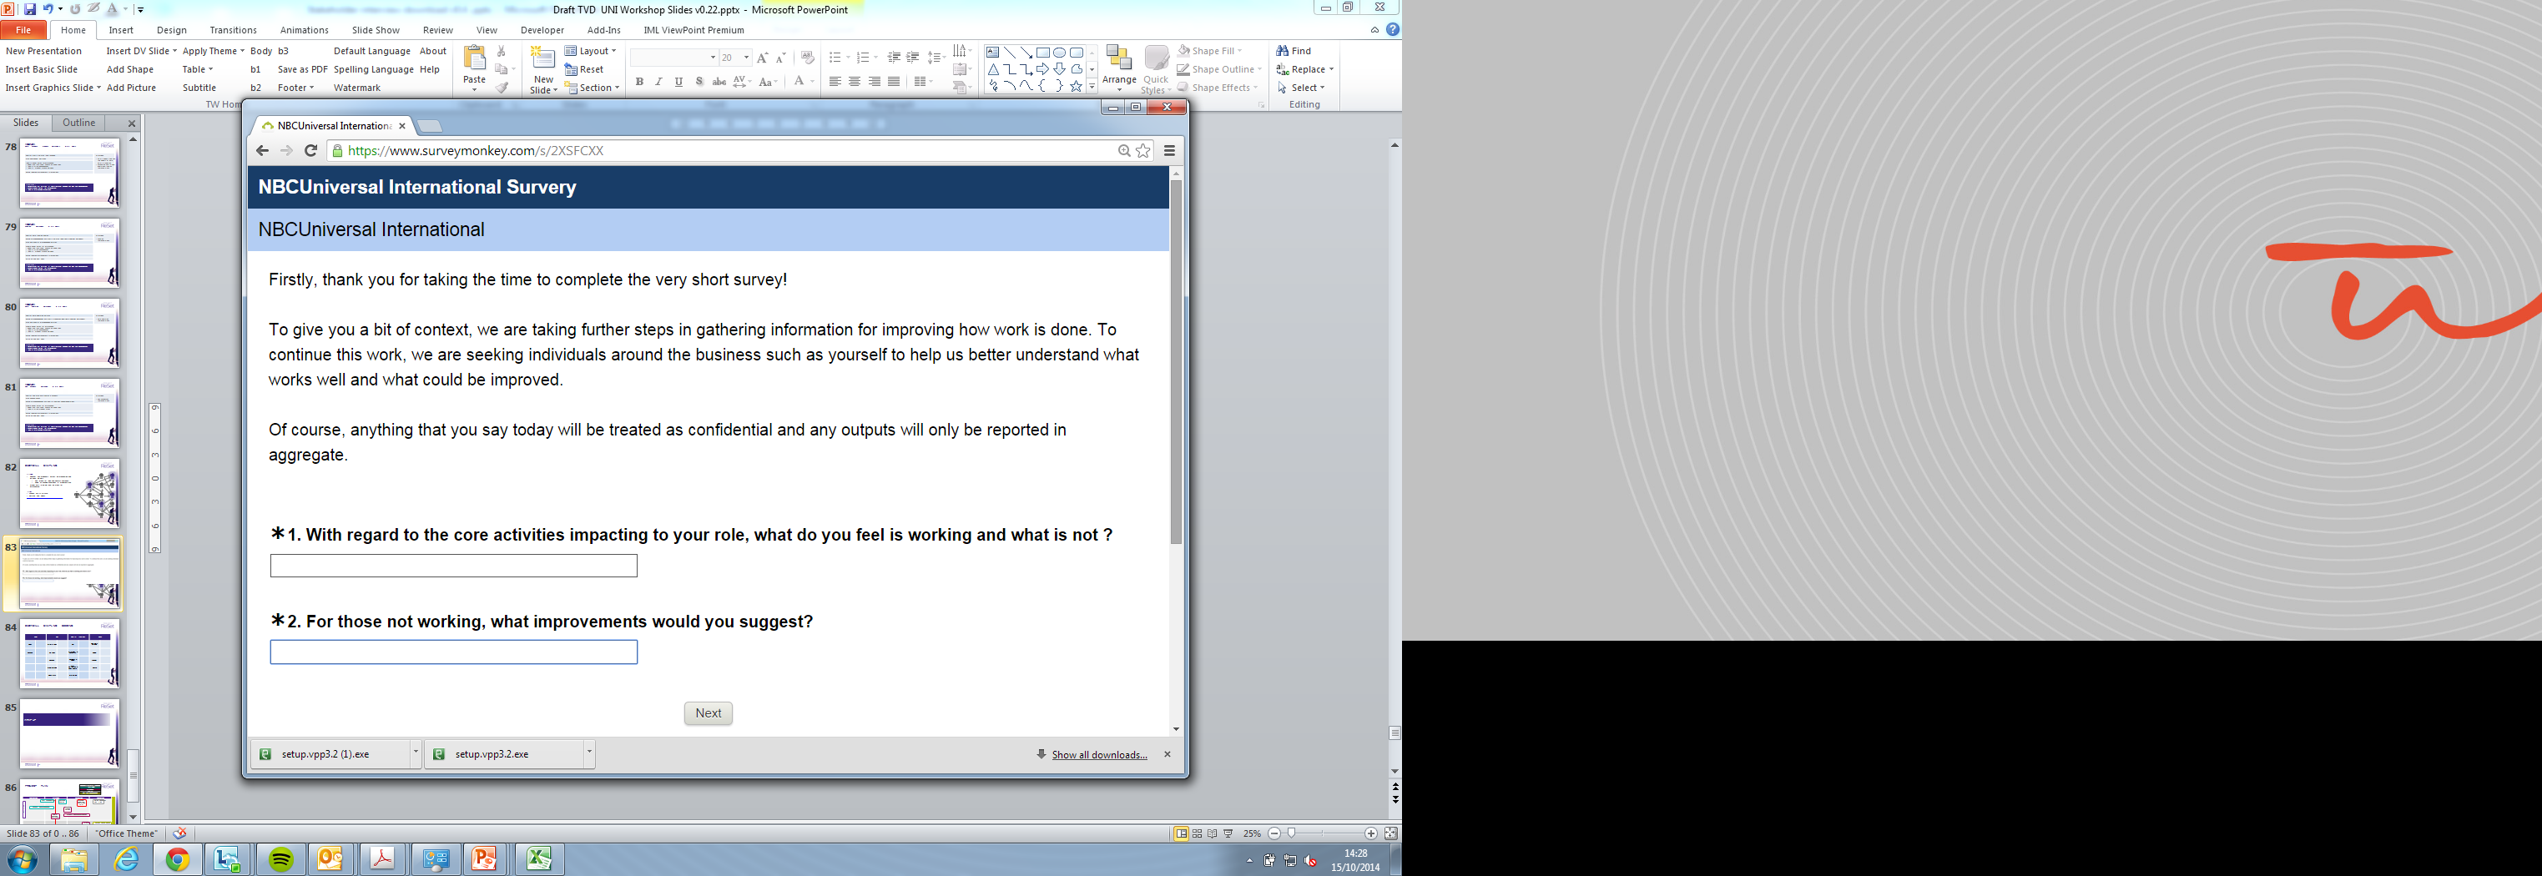
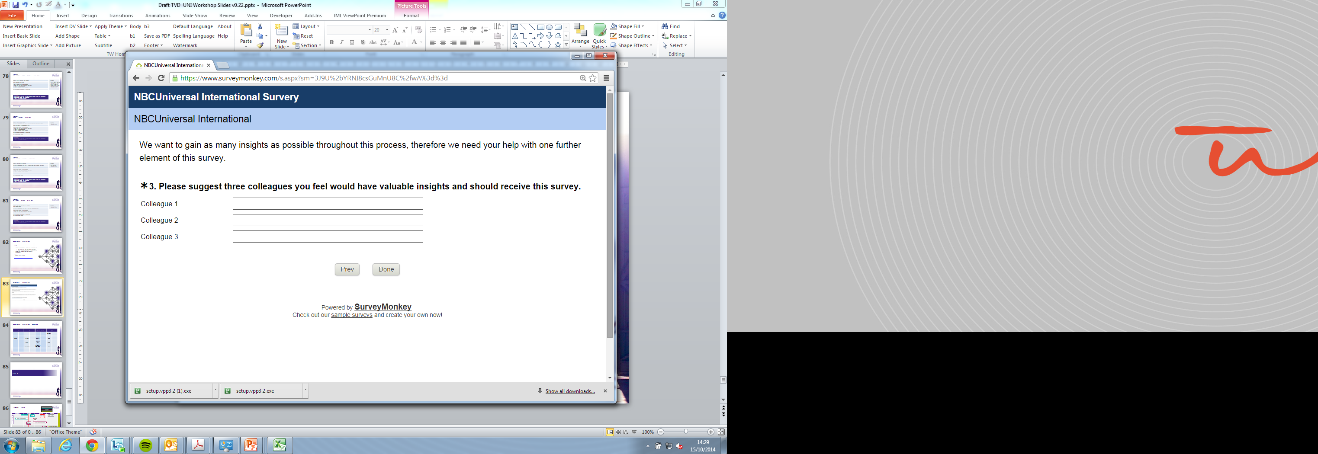
Sprint 2: Establish Change Agent Network (CAN)
Snowball Sampling
Purpose
To discover key influencers across the organisation and establish a network of people to test, challenge, refine and help implement changes
Respondent driven survey technique where each participant recommends future respondents
Used to identify hidden influencers across the business who can be critical to successfully embedding organisational change
‘Informal influencers’ brought into project to provide input and guidance on planning and direction
Develop into change leaders across the business leveraging their informal influence in embedding the new workflows and processes

Slide 15
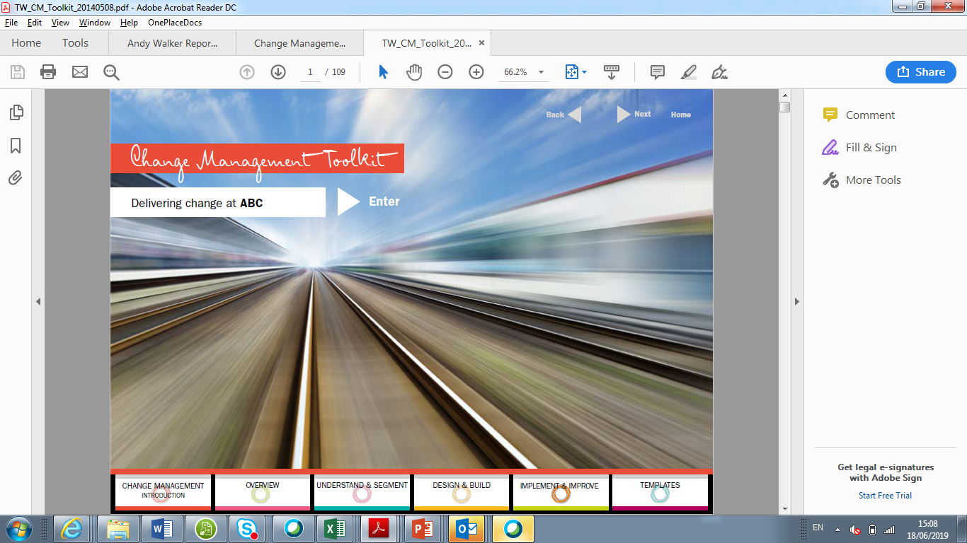
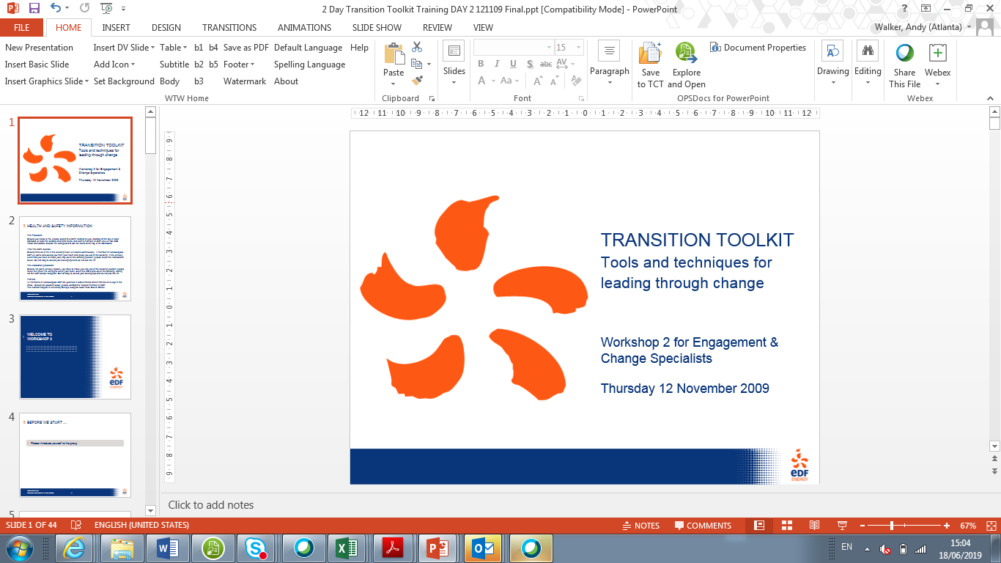

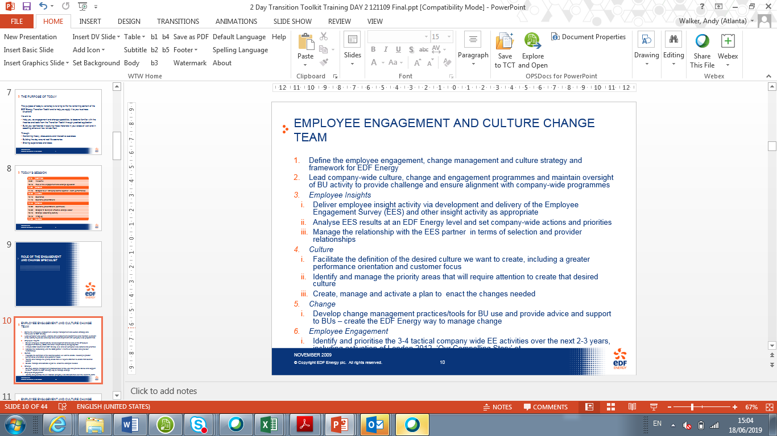
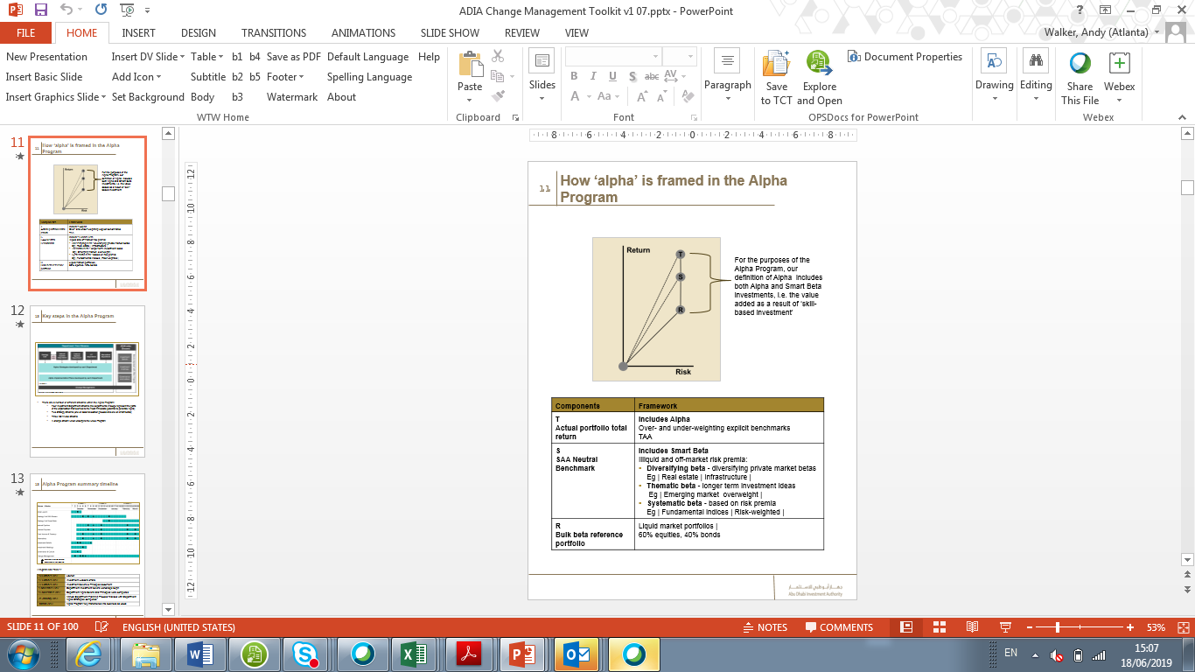
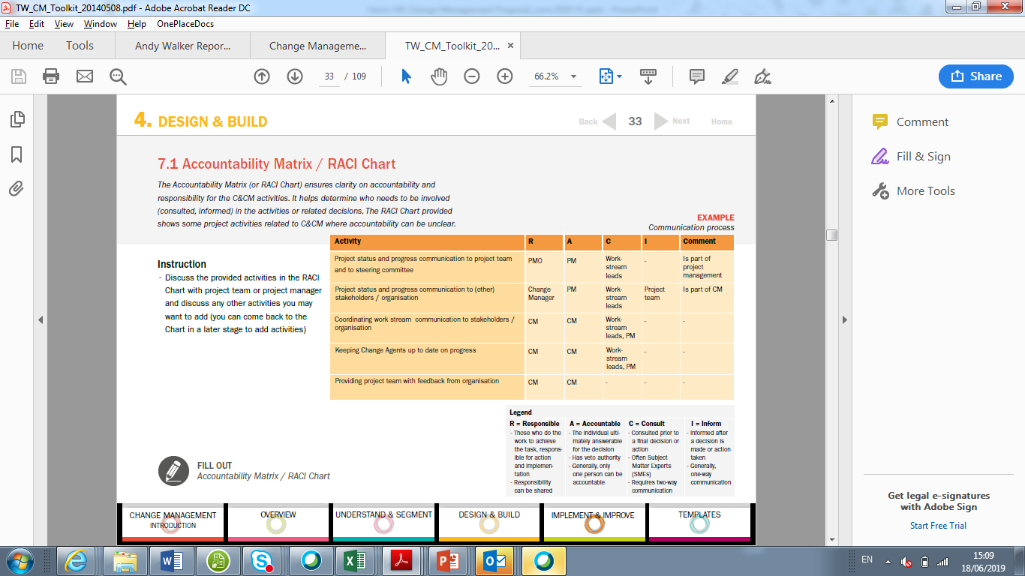
Sprint 3: Toolkits
Example Leadership and HR Toolkits

Slide 16

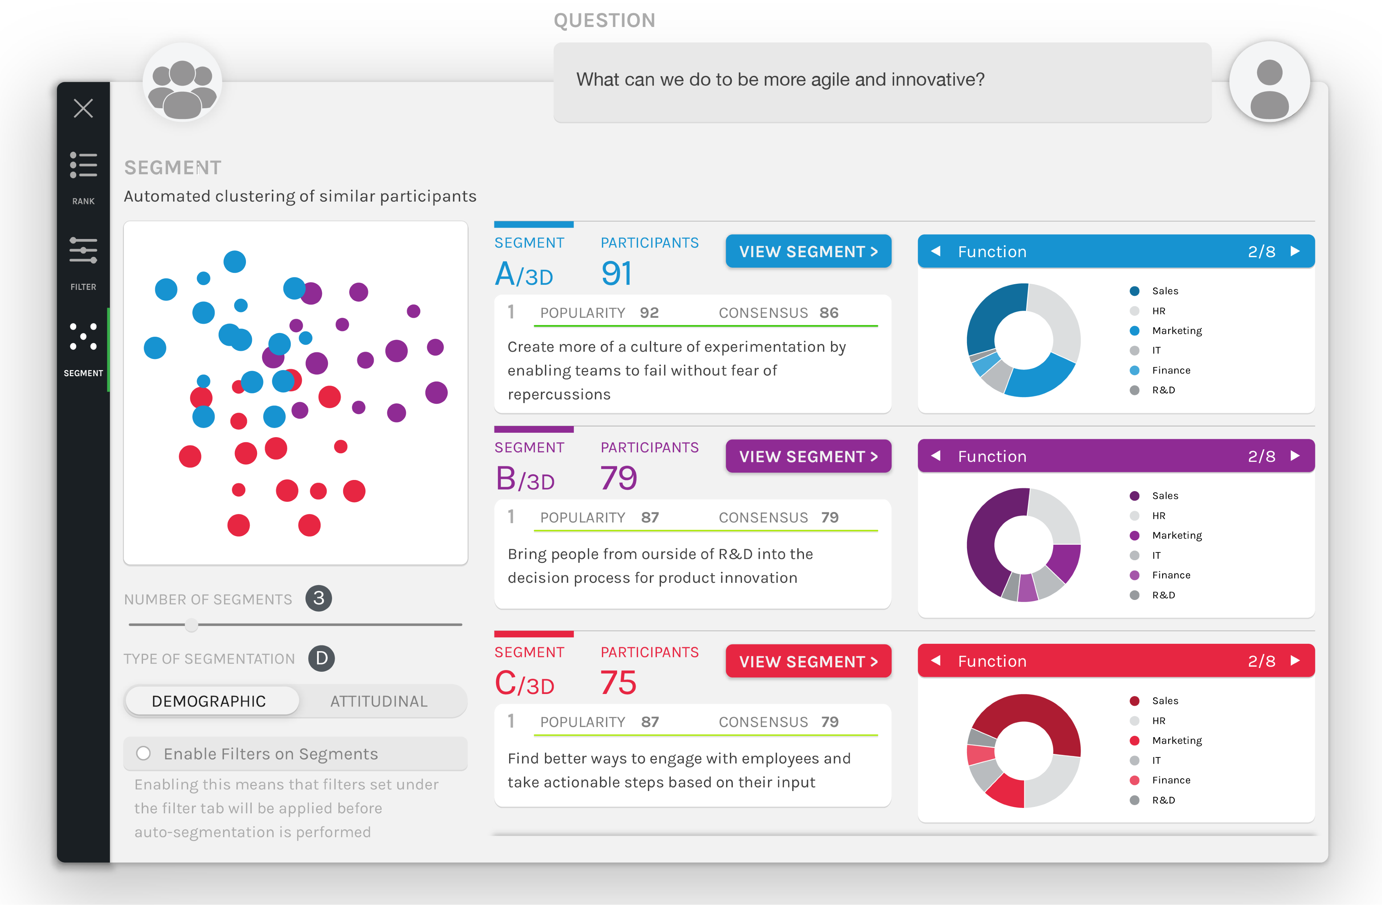
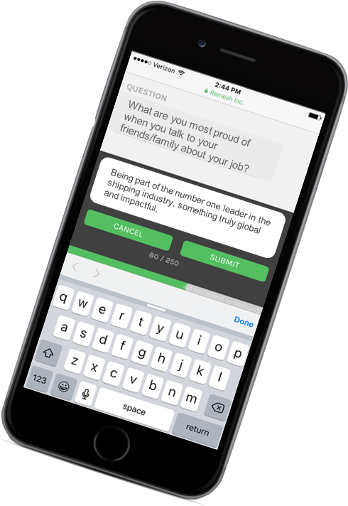
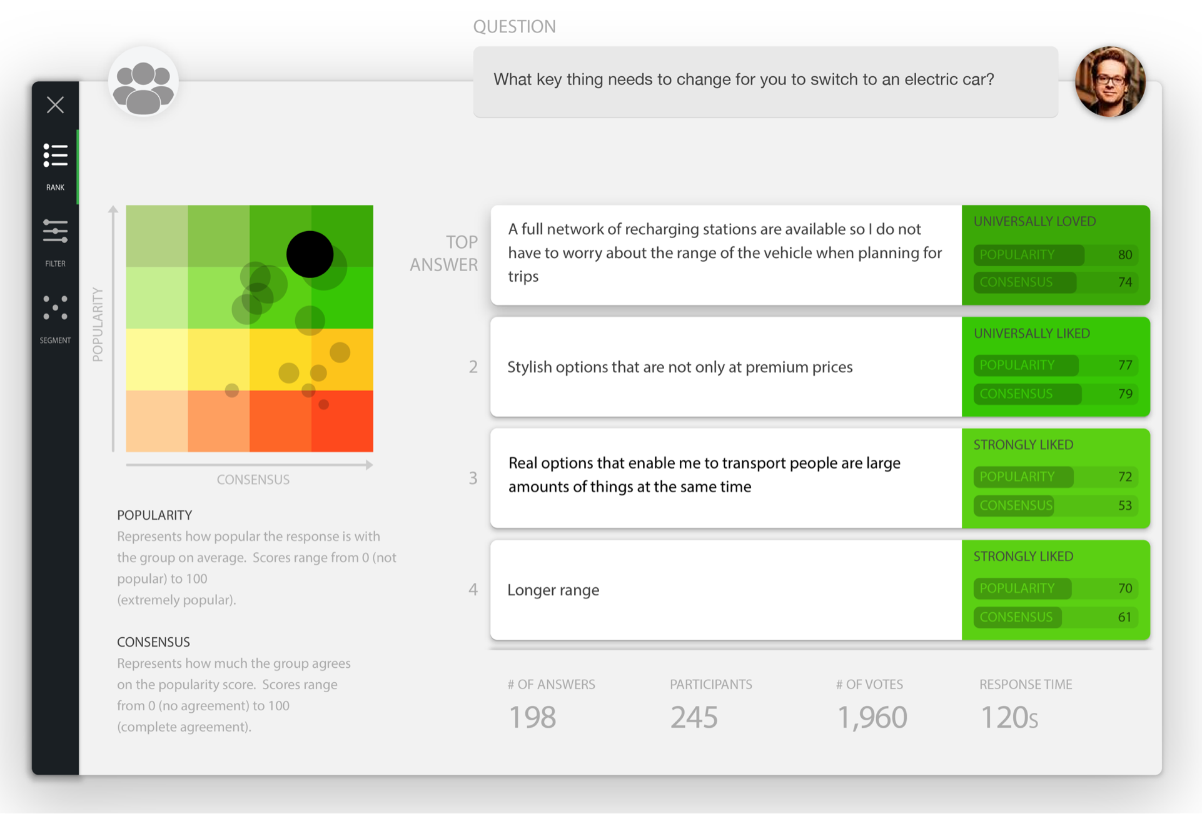
Sprint 4: Employee Virtual Focus Group
Artificial Intelligence Platform
Our artificial intelligence platform enables us to run virtual focus groups as part of our suite of listening tools that provide an engaging, innovative, quick and safe way to gather feedback and understand sentiment from large groups of participants in real time.
Safe and Secure: securely contact all members and offer a safe space for sharing feedback
Segment and Analyse: segment and categorize responses for in-depth analysis and insights
Listen and Grow: help to inform and prioritize improvements and establish an ongoing feedback process to engage and energize
The tool:
Combines the reach of a survey with the flexibility and depth of a focus group
Allows you to gather perspectives from large groups of people (up to 1,000 at the same time per session)
Fun, engaging and interactive way of seeking and analyzing participant perspectives
Quick and cost effective alternative to traditional focus groups
Provides deep, segmented insights in minutes

Slide 17
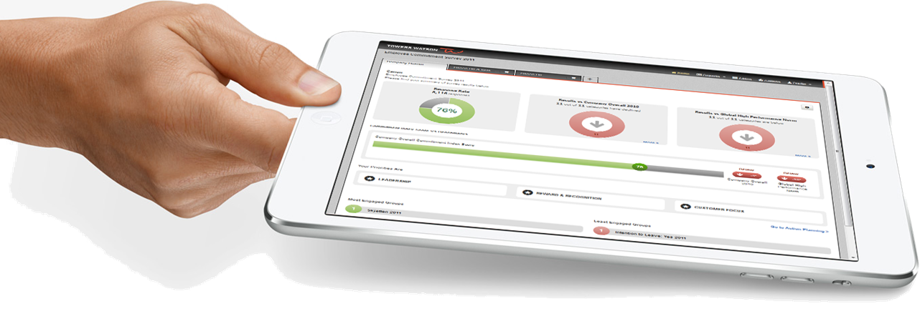
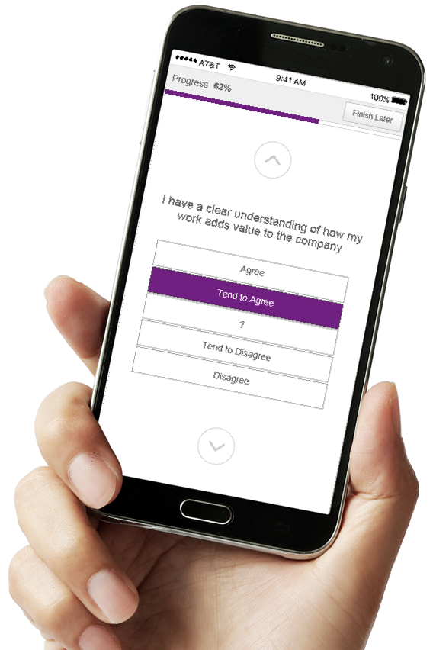
Sprint 4: Pulse Survey
Intelligent survey platform
Quickly and easily sense check employee sentiment and/or response to initiatives
Easily design and deploy employee surveys, using proven software
Choose from 400 validated questions and 400 annually updated benchmarks; administer in 73 available languages
The most cost effective way of ensuring continuous listening and measuring progress
Combine with: Willis Towers Watson Employee Engagement Software to enhance your listening strategy, build and trends and make it continuous
Output
A quick and agile way to obtain quantitative data
Assessment of engagement, impact, integration activities and effectiveness
Frequent pulse-taking (e.g., quarterly) measures the integration process to date

